Slide 1
CCS 2015:Tampering with the Delivery of Blocks and Transactions in Bitcoin
Lv Chenyang
Notes:
Today I want to introduce the paper :Tampering with the delivery of blocks and transactions in bitcoin

Slide 2
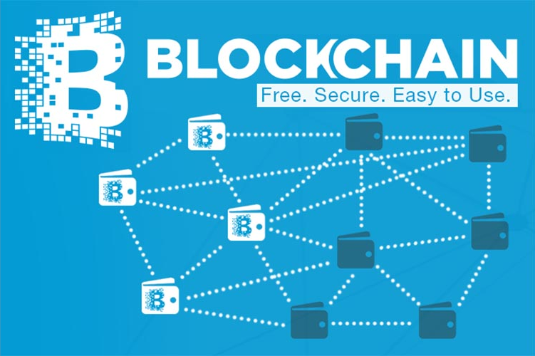
Notes:
at first,l'd like to introduce blockchain.blockchain is a distributed system,when a node has a transaction or a block, it should broadcast to let others know.most nodes confirm the object,then your object is valid. One node send the object to another,finally all nodes receive the object.

Slide 3
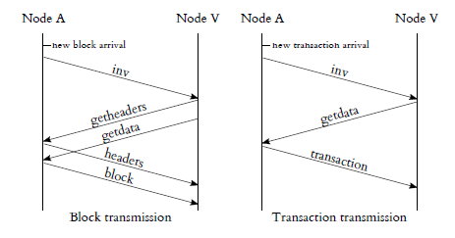
How message propagate
Notes:
When node A receive a new object,it will send inv message to neighbors.If a node V does not have the object ,it will ask node A for entire message.Then node A send the whole block or transaction.

Slide 4
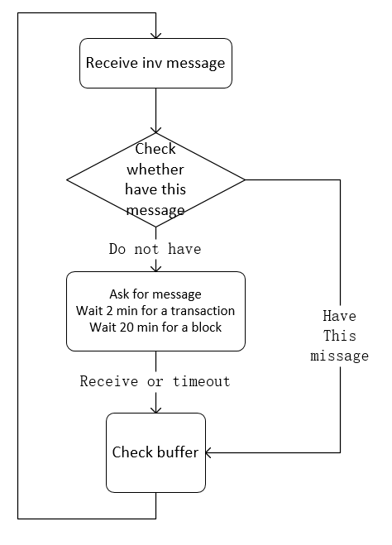
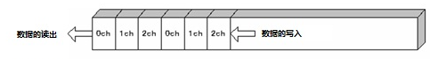
How message propagate
inv message
FIFO buffer
it's possible that other nodes send inv message to you when you ask for entire message .To minimize information spread in the network,the inv message will store in FIFO buffer.
Notes:
you can see from the flow charts,when a node receive inv message,it will check whether has this message.If it does not have, the node asks for the entire message.If the sender want to delay the message,the node will wait 2min for a transaction or 20min for a block,then the node check the buffer if there are inv messages.Then do it again.Although a node only wait 2minutes for transatction, the adversary can send 10 inv messages back to back and never send entire messages.In another word,the victim will waste 20 minutes.

Slide 5
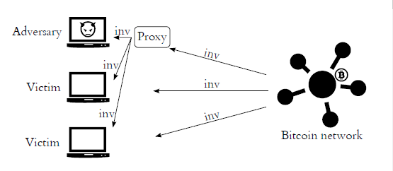
how adversary delay the message
adversary receives the message and then send the inv message to neighbors without check so that he can be the first to send inv message to victims.

Slide 6
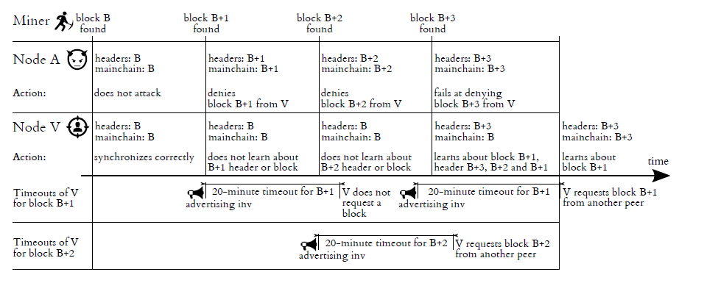
How adversary double-spending
Notes:
At this time a miner find a block and broadcast .Node A sends an inv message as soon as it gets the block.Node V waits for 20min and gets nothing.If node V does not request this block from other neighbors,node A will delay the victim again,

Slide 7
What adversary get
·increasing mining advantage
·selfish mining
·double-spending(fast payment)
Notes:
By delaying the message,the advbersary can increse mining advantage.And he can double-spending without risk.Double-spending means he uses one coin to pay two receivers.generally speaking,a transaction will be confirmed 6 blocks later.But there is fast payment which one block or none confirms the transaction and the receivers gives the goods.

Slide 8
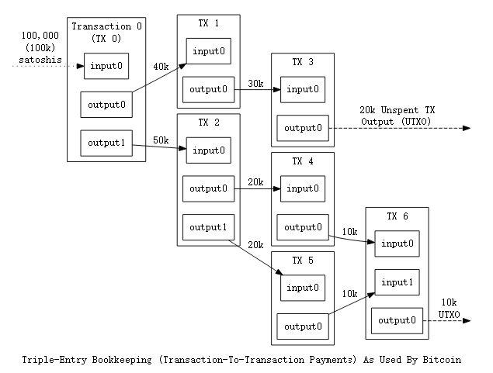
Notes:
Although person says he have how many Bitcoin,the fact is how many outputs that not use as an input belong to him and how many points these outputs value.When you want to use coins to pay, the fact is you create a transaction whose input belongs to you and output belongs to receiver.You can check the output to find out the coin belongs to whom.

Slide 9
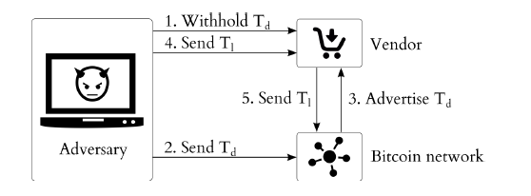
How adversary double-spending
zero-confirmation transactions
Notes:
When the adversary gets a coin,he creates two transactions Td and Tl sharing the same input.Td's output belongs to adversary and Tl's output belongs to victim.
He sends the inv message of Td to victim and never send transaction Td.Then he sends the transaction Td to bitcoin network so the network confirms the coin belongs to the adversary.the network sends the inv message and it is waiting in FIFO buffer.
Then adversary sends the transaction Tl to the victim.He checks the Tl's output and is sure it belongs to him which means the adversary pays.So the adversary gets the goods and then the network will not confirm the Tl because Td uses the same input and Td is confirmed.So the adversary does not lose the coin , he can use it to pay again.

Slide 10
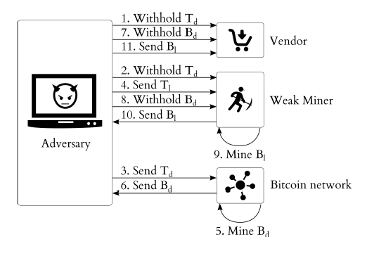
How adversary double-spending
1-Confirmation Transactions
Notes:
1-confirmation transactions need a block to confirm.So the adversary needs a weak miner to mine a block which confirms the Td and it is likely to discard this block ,or the adversary pays the goods.
the same Td and Tl share the same input.the adversary sends the inv message of Td to the victim and weak miner.Then he sends the Td to network,wait a moment , he sends Tl to weak miner.If bitcoin network mine a block Bd faster,the adversary withhold the Bd to the victim and weak miner.Then miner mines a block Bl which confirms the Tl.So the adersary sends the Bl to the victim and gets goods.Because the Bl is mined later it's more likely to discard the block Bl,so the adversary can use the coin again.

Slide 11
How to defense delay
·alternative relay networks ( Matt Corallo's relay network)
·Dynamic timeouts
·Updating Block advertisements
·No inv messages
·Keep track of block advertisers
·Handling Transaction Advertisements
·filtering by IP address
·randomly choosing sender
·Penalizing Non-responding Nodes
Notes:
The writer introduces some way to defense.
The first way is to build a message provide network,but Matt Corallo's relay network is badly-behaved.
I think dynamic timeouts is useless since you still have to wait for a long time if the adversary sends same inv messages back to back.
directly send the entire messages can solve the problem ,but I think it will use a lot bandwith.
By keep track of block advertisers,the victim can select the advertisers so it will not wait if the adversary send same inv messages.
If a node always delay the message ,ban the IP address.And randomly choose the sender rather than line from FIFO buffer.
PUNISH non-responding nodes.

Slide 12
THANKS!

